Slide 1
Opioid Settlement Planning Progress
Victoria Reichard, LCSW Behavioral Health Manager
County Manager’s Office
Justice Advisory Council
June 3rd, 2022

Slide 2
How Much Will Buncombe Receive?
Buncombe County will receive $16,175,039 over a 17-year period
In 2022, Buncombe County to receive $1,988,101

Slide 3
MOA Opioid Remediation Activities
Buncombe County is already supporting the Memorandum of Agreement’s approved strategies that are evidenced based & high-impact
1. Collaborative strategic planning​ | 5. Employment-related services | 9. Syringe Service Program
2. Evidence-based addiction treatment​ | 6. Early intervention | 10. Criminal justice diversion programs
3. Recovery support services​ | 7. Naloxone distribution | 11. Addiction treatment for incarcerated persons
4. Recovery housing support | 8. Post-overdose response teams | 12. Reentry Programs
Notes:
These are the 12 evidenced based, high impact strategies outlined in the MOA. Buncombe County is already actively practicing each of these strategies through a range of public services and community partnerships in line with the County’s strategic priorities around resident well-being, which are reducing jail population and enhancing public safety as well as eliminating deaths as a result of substance abuse.
The Behavioral Health Justice Collaborative is an example of strategy #1 as it was formed in late 2021 and serves to strengthen coordination and collaboration between city and county departments as well as community stakeholders. This collaborative will provide input on recommendations for use of the settlement funds. The county also hired a behavioral health manager and behavioral health and justice analyst to help oversee these efforts.
To give a high-level perspective of where these strategies are occurring within the county government today, our Emergency Services supports strategy #2, 3, 7 and 8. The Sheriff’s Office support strategies #2, 3, 4, 5, 7, 10 and 11 through detention facility programming. Justice Services is supporting programs related to strategy #3, 4, 5, 10, and 12. Our Department of Health and Human Services is supporting services related to strategy #3, 7, 9, 12 and then also #6 through support of The Partnership for Substance Free Youth.

Slide 4
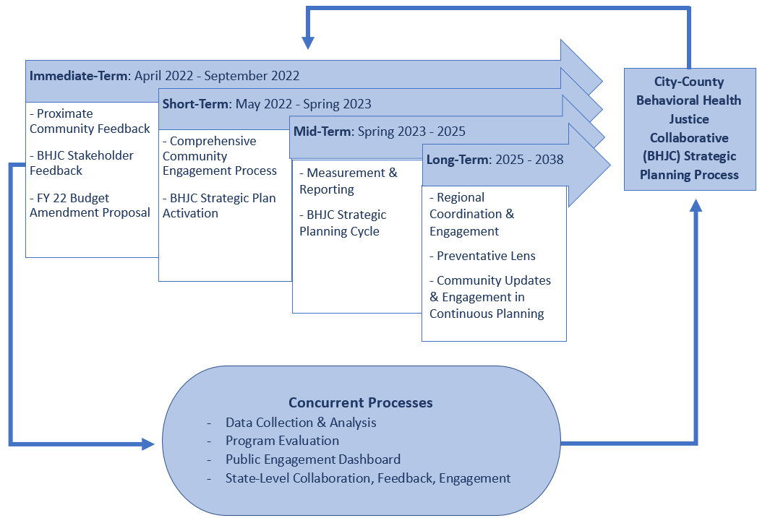
Planning for the Settlement Funds

Slide 5
Public Input Page
engage.buncombecounty.org/bcopioidfunds
To provide ongoing updates and one avenue to obtain feedback from the community
https://ncopioidsettlement.org/
State-wide dashboard

Slide 6
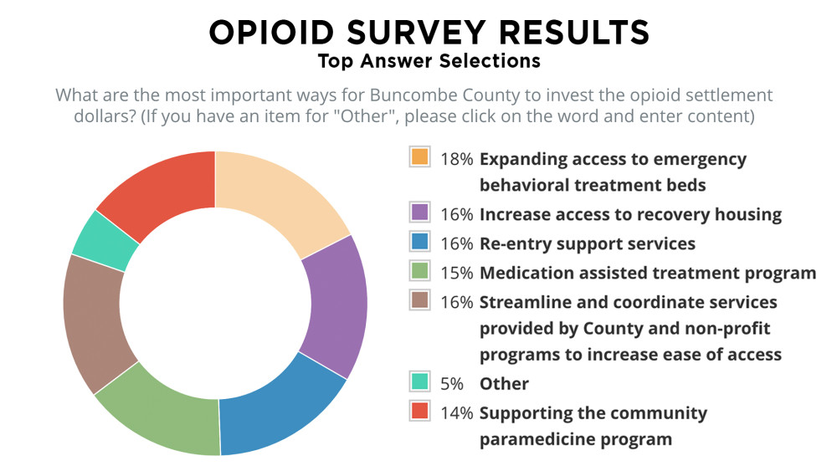
Notes:
One way that feedback was gathered was through our Public Input page. Participants were asked to rank a list of 7 strategies in the order they felt were most important for Buncombe County to invest opioid settlement dollars. A link to this survey was emailed out to various community groups that consisted primarily of people working in the helping field, which included many with lived experience and those having day to day interactions with people impacted by the opioid epidemic. This survey accessible from April 13th to May 25th, 2022. This pie chart indicates the percentage of people who ranked a particular strategy as their top answer. As one commenter mentioned “There is not one definitive solution to solving this pandemic of the opioid crisis”, “it takes the WHOLE community and all of these needs getting attention to stop more people from dying.”

Slide 7
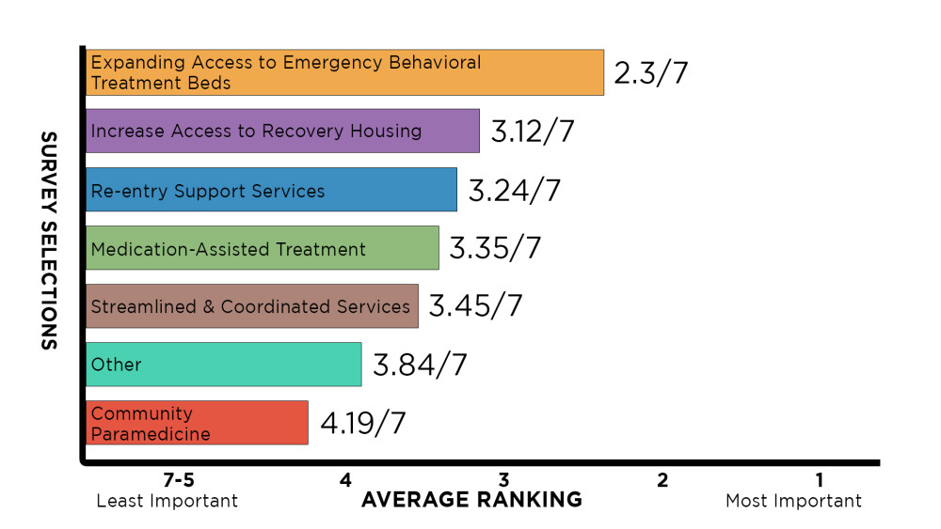
OPIOID SURVEY RESULTS
Notes:
This bar graph, takes the same data, but shows the average ranking of each option. For example, if one person ranked an option as their 1st choice, and another person ranked that same option as their 3rd choice, the option's ranking would be 2. Items listed as other included Harm reduction services; Money to increase the length of stay in inpatient treatment; Initiatives targeted to adolescents, even intensive outpatient

Slide 8
Behavioral Health Justice Collaborative Meetings
From Pestle Analysis 3/10 & 4/8
Need for greater collaboration between government services
Accessible housing (considering cost, licensing, and behavioral barriers to housing resources in the community)
Addressing the influence of historical & generational trauma among impacted communities
Re-entry services
Restorative justice
Need for data sharing across programs
4/8/22 Group Conversation
Increased representation and inclusion among service providers and service delivery in the most impacted communities
Increase peer supports available throughout the community
Increased incorporation of trauma-informed principles into emergency and crisis-response procedures
Maintain accountability for dangerous/unlawful behaviors in the community
Reduce criminal detentions stemming from mental health and substance use-related behaviors
Notes:
Our other venue of gathering proximate community feedback is through the Behavioral Health Justice Collaborative where a diverse group of community stakeholders identified problems/needs/barriers in our community and then prioritized those items for settlement funding. There were also conversations regarding ideas to better support our community.

Slide 9
Areas of Initial Focus
Sustainability of existing programs
Post Overdose Response Team = Meet current staffing demand & supplies
Addiction Treatment for Incarcerated Persons = BCDF MAT program
Syringe Service Program = Program sustainability
Recovery Support Services = Increase Peer Support & Social Determinants of Health-related supplies
Recovery Housing Support = Increase access by reducing financial burden and increasing higher access options (Longer Term = creating a “recovery housing navigator” to help programs meet ethical standards, secure sustainable funding sources)
Collaborative Strategic Planning = Identify goals, measures, and evaluation plan
Evidenced Based Treatment = expanding access to residential treatment and outpatient treatment
Employment Related Services
Notes:
In our last Behavioral Health Justice Meeting, we continued to dive deeper in identifying strategies to work on the needs of the community and those that aligned with the Memorandum of Agreement for Opioid Settlement Money. Reflecting on previous meeting outputs as well as the public input page results, these were items initially identified. There was consensus of the group that sustaining current programs would be a priority if current funding is not covering the need and/or is expiring. While we are working with existing programs to define the amount and when funds will be needed as well as further planning for the other identified strategies, we will be obtaining feedback from the BHJC on prioritizing the strategies.

Slide 10
Questions/Discussion

