Slide 1
JRAC Retreat
Strategy & Innovation

Slide 2
Purpose of Retreat
Establish clarity around the role and purpose of JRAC
Celebrate and acknowledge accomplishments
Begin to set priorities moving forward

Slide 3
JRAC Purpose
To serve as an advisory body to the policy makers, judiciary, and stakeholder groups of the criminal justice system in Buncombe County. The JRAC examines potential improvements to the system, sets priorities, make recommendations, and guides with their implementation. The JRAC utilizes evidence-based methods to identify goals and priorities, develops solutions, and measures results to ensure policies and programs are cost effective, efficient, and produce maximum outcomes for the community.
Purpose in members’ own words – themes included:
bringing criminal justice partners together for collaboration,
gathering/listening to input from a variety of stakeholders,
monitoring efforts and efficiency, and
problem identification and problem solving.

Slide 4
Strengths and Challenges
Strengths | Challenges
Learning – educating leaders about the justice system | Institutional inertia - inability of institutions to formulate timely responses
Collaboration with JRAC partners and community | Lack of sufficient community resources – have a lot of resources but are they the right kind of resources, community members not aware of the resources available
Leveraging external resources (technical assistance, grants) | Key stakeholders are missing/not engaged – judges, magistrates, APD, Probation, Juvenile Justice
Access to communication teams | Agency staffing issues continue, making participation difficult for some offices
Data-driven/informed discussions | Staying on top of relevant issues, as they can change at a fast pace (ex: COVID)
Developed strategic plan during COVID | Sharing information with towns
City/County leadership representation | Sharing data
Ability to problem solve | Competing missions and goals, both within JRAC and in the community – sometimes the same goal but on different paths to achieve

Slide 5
Applying CJCC National Standards
Standard 2: Bylaws Standard
2.1(b) CJCC bylaws shall include, at a minimum, the following: 1) official name of the council, 2) purpose of the CJCC, 3) authority of the CJCC, 4) list of members by position, 5) requirements for meetings, 6) CJCC officers and their duties, 7) requirements for committees or workgroups, 8) parliamentary-style rules for speaking and vote taking, 9) requirements for disclosing conflict of interest, 10) staff responsibilities, 11) guidelines for strategic planning and annual reports, and 12) requirements for amending the bylaws.
Reason: Clarify roles/purpose of JRAC as it related to executive member functions

Slide 6
Applying CJCC National Standards
Standard 3: Membership Standard
Standard 3.1(b): CJCC membership shall include key justice system professionals that may include, but not be limited to, the chief judge of the felony criminal courts, chief judge of the misdemeanor courts, police chief, sheriff, jail administrator, chief prosecutor, public defender and/or chief defense bar attorney, clerk of court, probation/parole chief, pretrial services director, officials of general government (e.g., county/city manager), and directors across the continuum of care (e.g., substance use disorder, mental health, housing).
Reason: Need for engagement/re-engagement of key stakeholders

Slide 7
Applying CJCC National Standards
Standard 5: Executive Committee Standard
5.1(a): The CJCC shall have an executive committee responsible for guidance and management of the CJCC.
Standard 5.1(b) At a minimum, the CJCC executive committee shall include the officers and a small fraction of the CJCC membership.
Standard 5.2: The executive committee shall include the CJCC director in meetings and provide direction to the position.
Reason: Agenda setting for JRAC

Slide 8
Applying CJCC National Standards
Standard 6: Standing Committees and Workgroups
Standard 6.1(a): The CJCC shall create and utilize standing committees to address complex, ongoing priorities and strategic plan initiatives.
Standard 6.1(b): The CJCC shall create and utilize workgroups to address task-specific and time-bound initiatives.
Standard 6.2: Membership of standing committees and workgroups shall include CJCC members and nonmembers with subject matter expertise and lived experience.
Standard 6.3(a): Standing committees and workgroups shall have a chair and vice-chair or, alternatively, co-chair(s).
Standard 6.3(b): The CJCC director and/or staff shall act as support to subcommittees and workgroups and serve as liaison for the CJCC and the executive committee.
Standard 6.3(c) Sufficient communication shall be maintained among committee/workgroup members, and with the CJCC, to maintain continuity and progress toward goals and objectives.
Reasons: Internal communication; workgroup structure, work and communication, workgroup scope and purpose

Slide 9
Applying CJCC National Standards
Standard 9: Strategic Planning
Standard 9.1(c): The strategic plan shall be specific, measurable, achievable, relevant, and time-bound and shall guide the focus of the CJCC, executive committee, and committees.
Reason: Need for SMART goals in next strategic plan to easily determine progress and aid in accountability

Slide 10
Applying CJCC National Standards
Standard 11: Community Engagement & Outreach
Standard 11.1: The CJCC shall purposefully engage the community.
Standard 11.2: The CJCC shall proactively work to educate and inform the public about the progress and challenges in the criminal justice system.
Standard 11.3: The CJCC shall make spokespersons available for community outreach.
Standard 11.4: The CJCC shall maintain, at a minimum, a website that provides the community access to CJCC information and resources.
Reason: Need for external communication and engagement around the role and purpose of JRAC

Slide 11
Applying CJCC National Standards
Standard 12: Administration
Standard 12.1: The CJCC staff shall be impartial and objective, responsible for data-driven consensus building representative of the best interests of the local criminal justice system.
Standard 12.2(a): The CJCC shall have a dedicated director who is accountable to the CJCC’s executive committee.
Standard 12.2(b): The CJCC director shall be selected and approved by the executive committee.
Standard 12.2(c): The CJCC and its director shall have appropriate staff to support the CJCC’s operations, goals, and objectives.
Standard 12.3: The CJCC shall have sufficient sustainable resources to manage its operations and accomplish its goals and objectives.
Standard 12.4: The CJCC shall seek internal and external funding opportunities to address CJCC goals and objectives.
Reason: Participants raised questions regarding the staffing structure for JRAC

Slide 12
Achievements & Priorities
Immediate need to re-engage partners
Attendees identified and made plans for outreach to identified members

Slide 13
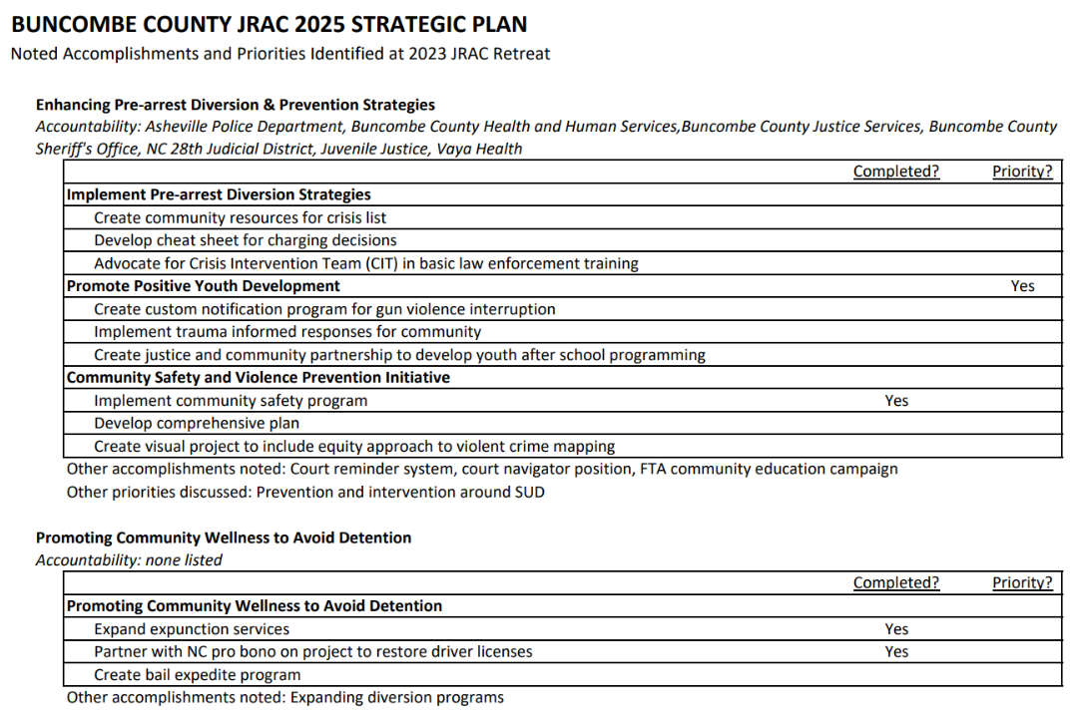
Achievements & Priorities

Slide 14
Strategy & Innovation Recommendations
Review JRAC strategic plan as a full body to set next fiscal year priorities, building off priorities identified during retreat. Recommend identifying 3-4 priorities for JRAC to work on in the coming year.
Evaluate bylaws to align with identified CJCC National Standards, including:
Confirm JRAC authority and reporting relationships and clearly document.
Create team charters for the workgroups outlined in the by-laws, clarifying structure and purpose of workgroups.
Strengthen communication within JRAC. This includes communicating around the role and actions of workgroups as well as following up with membership when priorities are acted upon/implemented. Building such updates into the meeting agenda would be beneficial.

Slide 15
Strategy & Innovation Recommendations
Future Meetings
Hold in courthouse to increase meeting accessibility for court partners.
Clarify/identify tangible outputs from JRAC meetings.
Consider re-starting Executive Committee meetings for agenda setting purposes. This could be done once a year or bi-annually, with the goal of establishing all agendas for a 12-month or 6-month period. Align meetings with county budget and state legislative calendar.
Create standing agenda items, these could include:
Subcommittee highlights and membership review via workgroup chairs
HIAC Workgroup updates (and/or incorporate this as an update from the BHJC).

Slide 16
Strategy & Innovation Recommendations
Example annual meeting schedule
Meeting 1 Identifying priorities for the next year | Provide direction to workgroups
Meeting 2 Focused Meeting with Workgroup 1 | Present progress on priorities, upcoming recommendations, or workgroup needs
Meeting 3 Focused Meeting with Workgroup 2 | Present progress on priorities, upcoming recommendations, or workgroup needs
Meeting 4 Focused Meeting with Workgroup 3 | Present progress on priorities, upcoming recommendations, or workgroup needs
Meeting 5 Final recommendations from workgroups presented to JRAC and vote | Recommendations from workgroups presented to JRAC (include any community or system stakeholder involved in or playing a role in recommendation, opportunity for JRAC to ask for additional information); final discussion and vote on recommendations to move forward to BOC for funding request and/or state advocacy

